Slide 1


2019 ~
www.miri_portfolio.com
Software Engineer
Portfolio
Mingyu Kim

Slide 2










About Me
EDUCATION
2011.03 - 2014.02) Bojeong Higschool
2014.03 - 2020.08) Hansung University
Library and Information Science
Computer Engineering
SKILLS
EXPERIENCE
2020.04 – 2020.06) FastCampus : Android developing app all-in-one
2020.06. – 2020.08) FastCampus : Algorithm & Technical Interview
2021.02. – 2021.04) FastCampus : Developing Game with C# and Unity
Certificate
Engineer Information Processing (2019.11.22)
SQLD (2020.06.30)
2급 정사서 (2020.08.20)
Driver’s License (2014.01.28)
TOEIC 695 (2020.02.09)
CONTECT
Phone
E-mail
Website
GitHub
010 – 3198 - 6905
ralskwo@naver.com
https://mayquartet.tistory.com/
https://github.com/ralskwo
Software Engineer
MinGyu Kim

Slide 3
Index
Android Project
My SNS
implements Instagram, YouTube, and Melon
Unity Project
Virtual Archive
Maze of Death
Virtual Reality Museum what turns Image to Video
Escape to Maze
C Project
Fire Alarm System
Blue Marvel
Fire Alarm System with Raspberry Pi
implements the Blue Marble game with C.
Snake Game
Push Push
your tail gets longer when you eat an item
Sokovan game implemented with C.
Web Project
Knot Specialist
introduce the Korean traditional crafts, Knotjang.

Slide 4
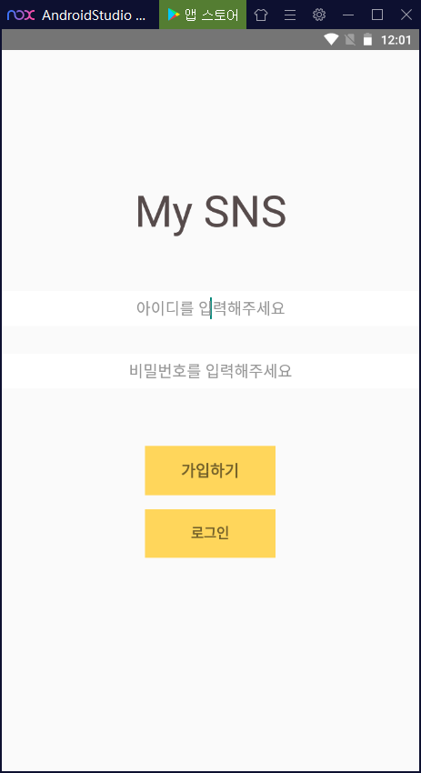
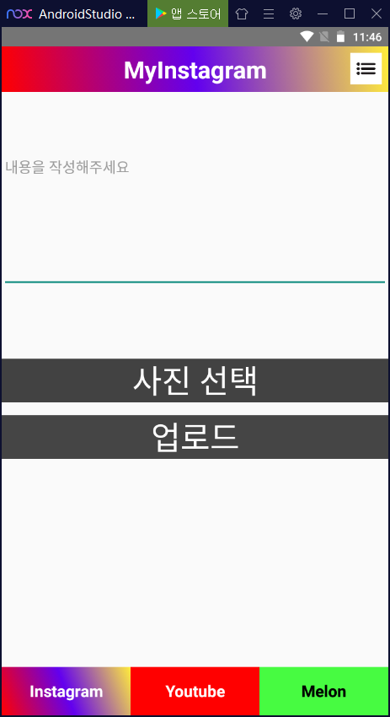
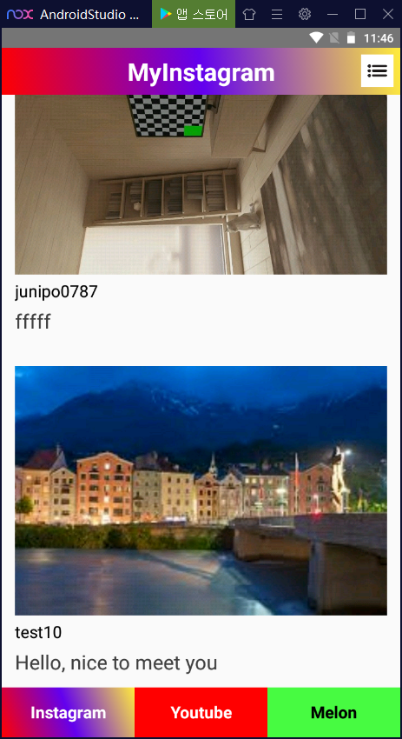

My
SNS
2021.03
~ 2021.04
Summary
It is a project that implements Instagram, YouTube, and Melon.
Mingyu Kim
My Contribution
The MellowCode site was used as a server.
implemented Join and Login functions.
You can upload photos, the ID of the person you uploaded, and the contents of the photo.
Personal Project.
All Part
Github URL : https://github.com/ralskwo/MySNS

Slide 5
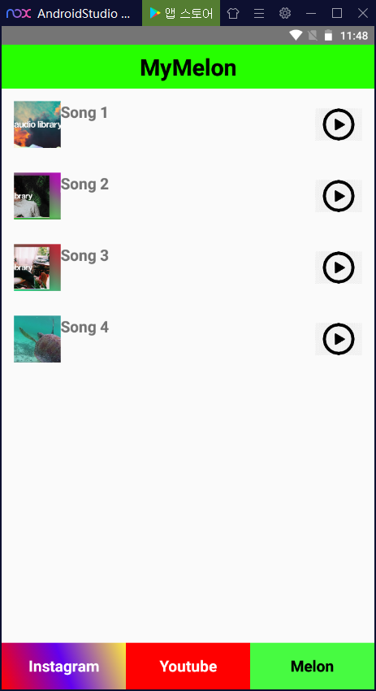
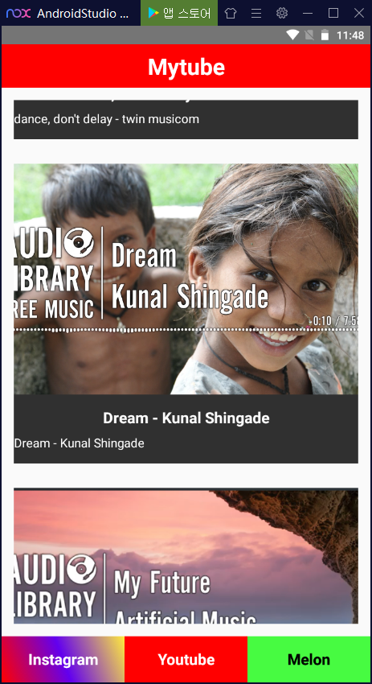
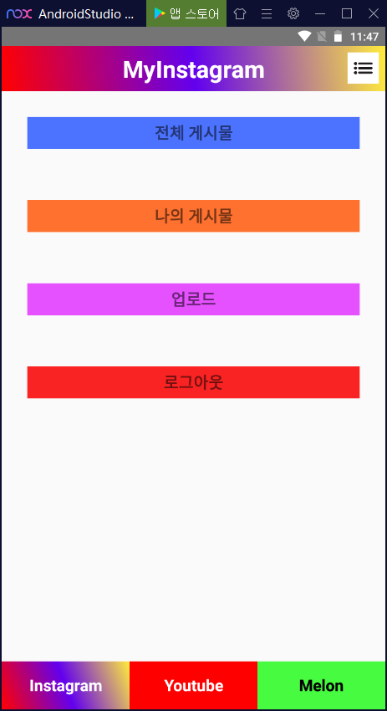
My
SNS
2021.03
~ 2021.04
Summary
It is a project that implements Instagram, YouTube, and Melon.
Mingyu Kim
My Contribution
YouTube and Melon are also available through the tabs below.
YouTube offers video playback and Melon offers music playback.
The menu icon in the upper right corner allows you to perform various actions or logouts that you can perform on Instagram..
Personal Project.
All Part
Github URL : https://github.com/ralskwo/MySNS

Slide 6
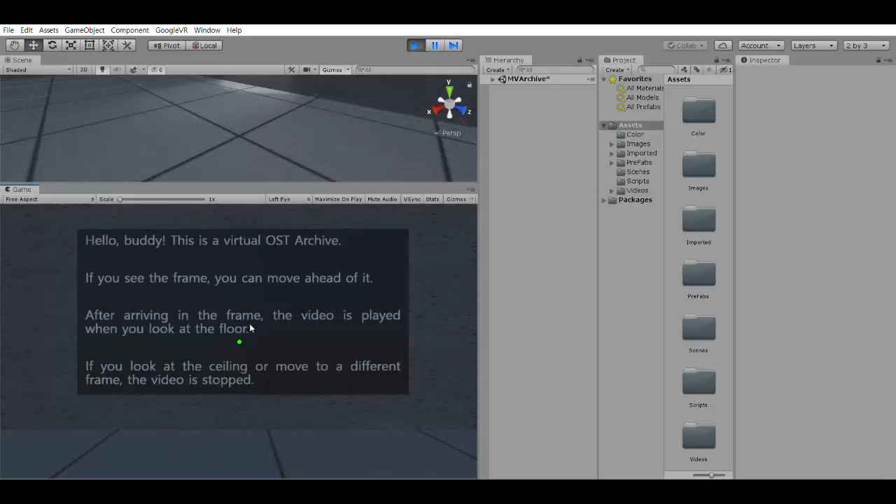


Virtual
Archive
Demonstration video
2019.10
~ 2019.12
Summary
Many movie song scenes are arranged in pictures. When you stand in front of a picture, the picture is converted to video and played.
Mingyu Kim
My Contribution
It is moved using gaze processing, and when it arrives in front of the image and looks at the floor, the image changes a video and executed.
When you view the ceiling or move to a different image, the video that was running ends.
It was implemented as a virtual reality application using Google VR's cardboard.
Personal Project.
All Part

Slide 7
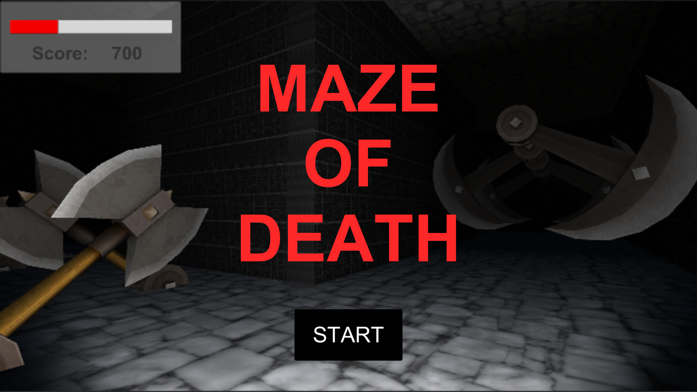
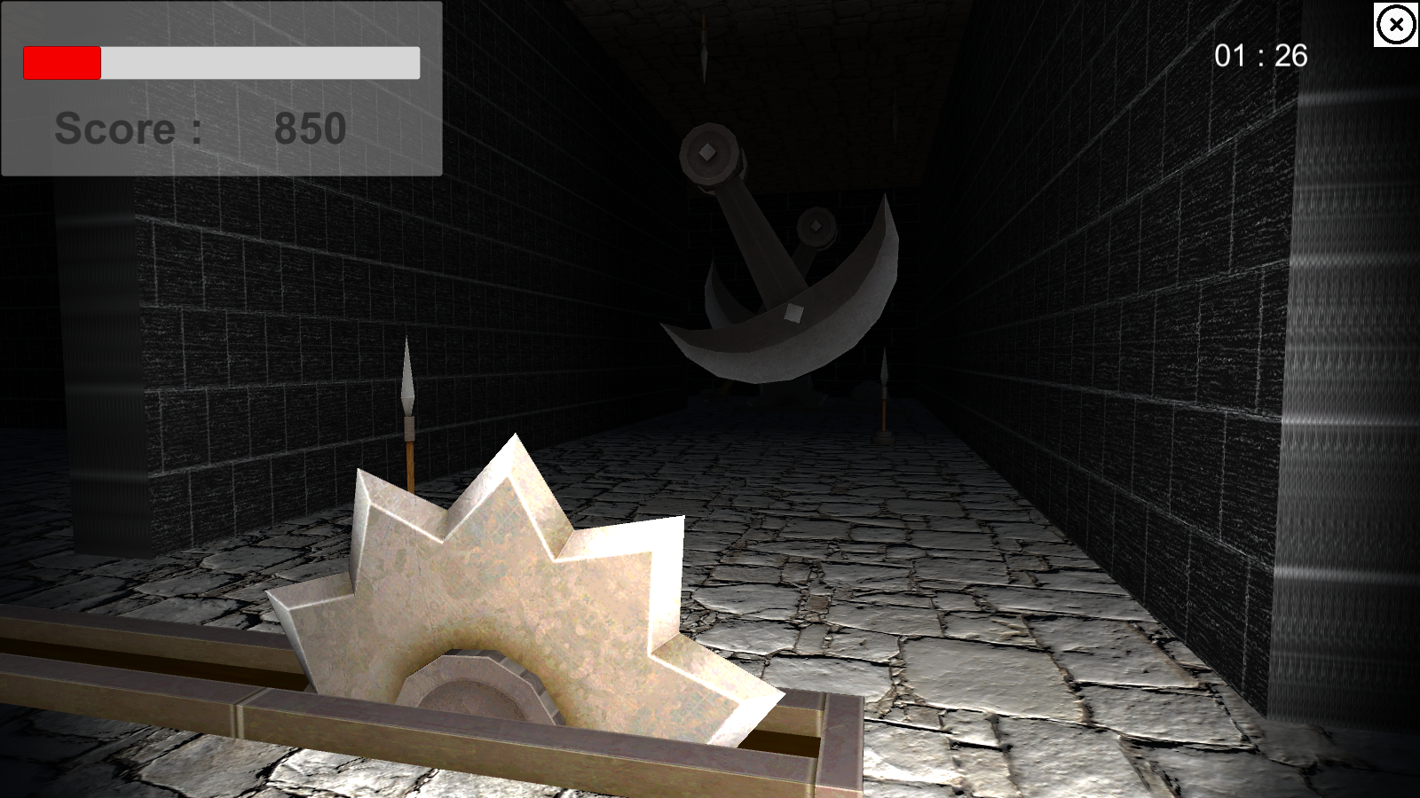
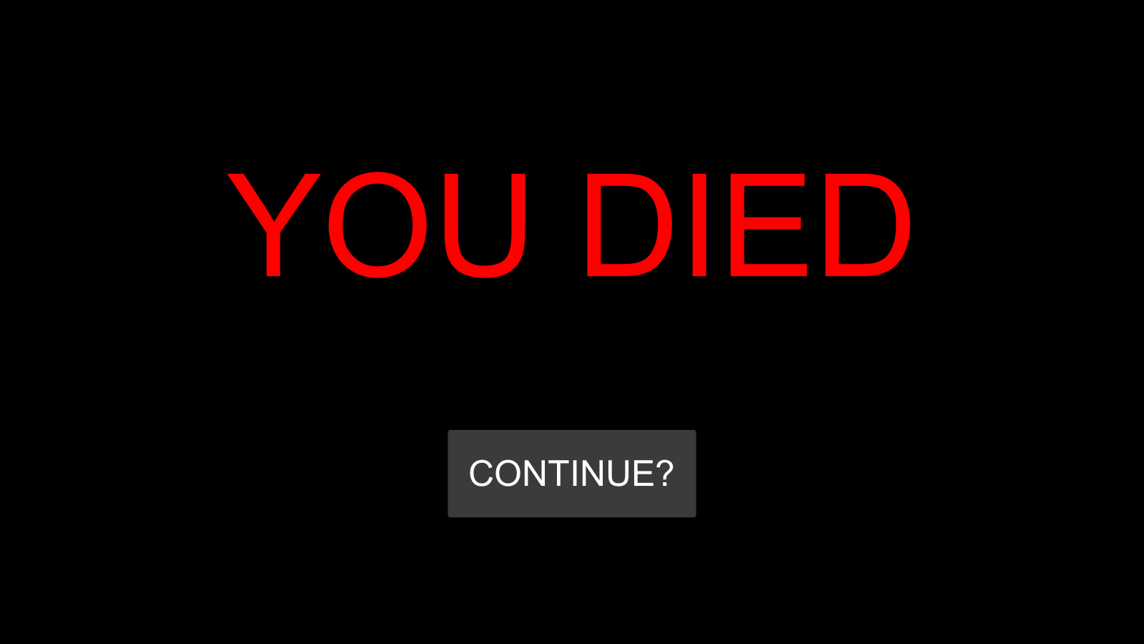
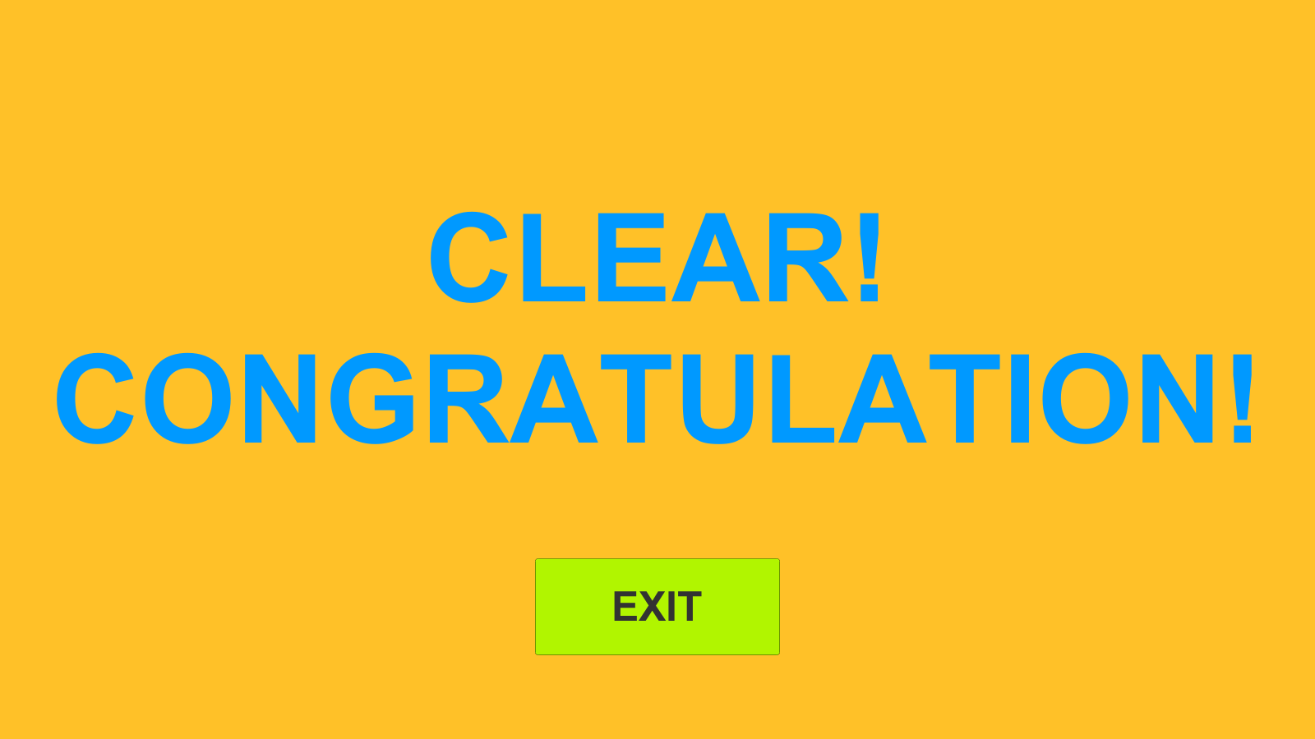
Start Scene
InGame Scene
Maze of
Death
Dead Scene
Clear Scene
2021.03
~ 2021.04
Summary
This is a maze escape game made using Unity. It is characterized by various traps and items arranged.
Mingyu Kim
PC/Mac platform-based
Use the keyboard to move and use the mouse to change direction.
If you run into a trap, you lose your HP.
Items placed throughout the map can improve scores or restore HP.
My Contribution
Personal Project.
All Part
Github URL : https://github.com/ralskwo/MyGames

Slide 8
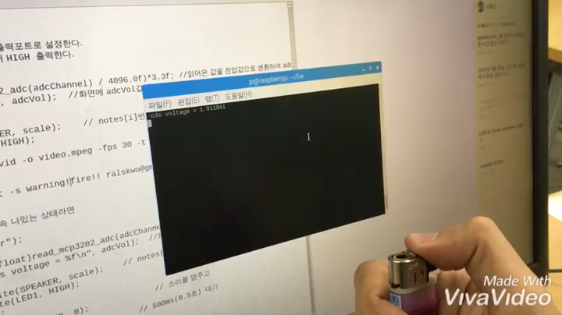


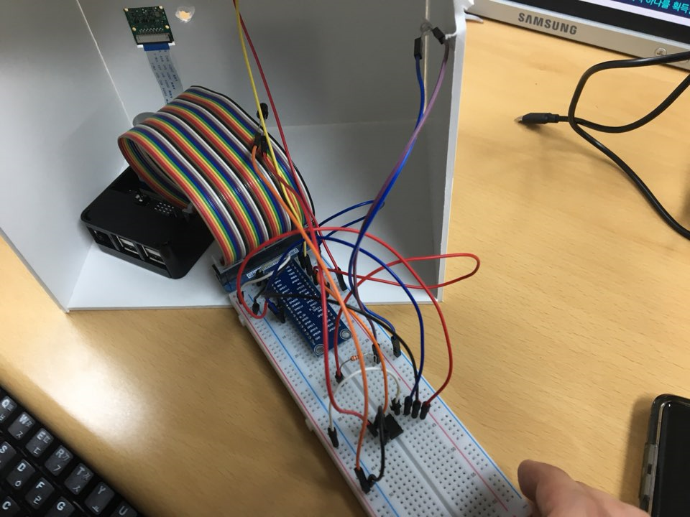
04
Fire Alarm
System
Demonstration video
Picture of Circuit
2018.10
~ 2018.12
Mingyu Kim
Suhyun Im
This is a project using raspberry pie. Implemented using C in a Linux environment.
When the fire detection sensor detects a fire, the hazard warning lamps flash and sound an audible warning.
Also, the fire news is sent to the user via Google Mail.
When detecting a fire, the purpose is to attach a camera, take a picture, store it for a certain period of time, and pinpoint the cause of the fire.
My Contribution
Scripting source code
Assembled a raspberry pie circuit.
Github URL : https://github.com/ralskwo/FireAlarmSystem

Slide 9
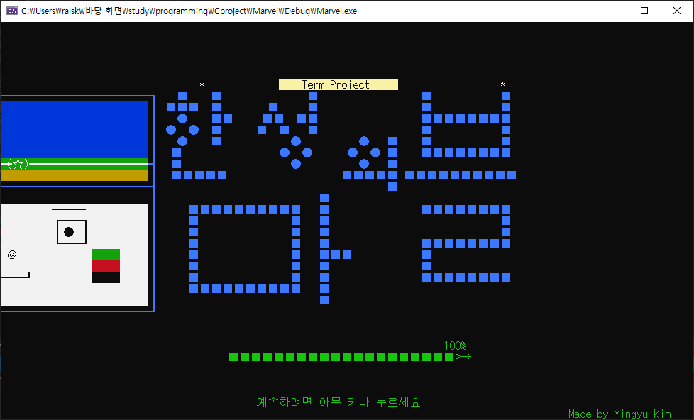
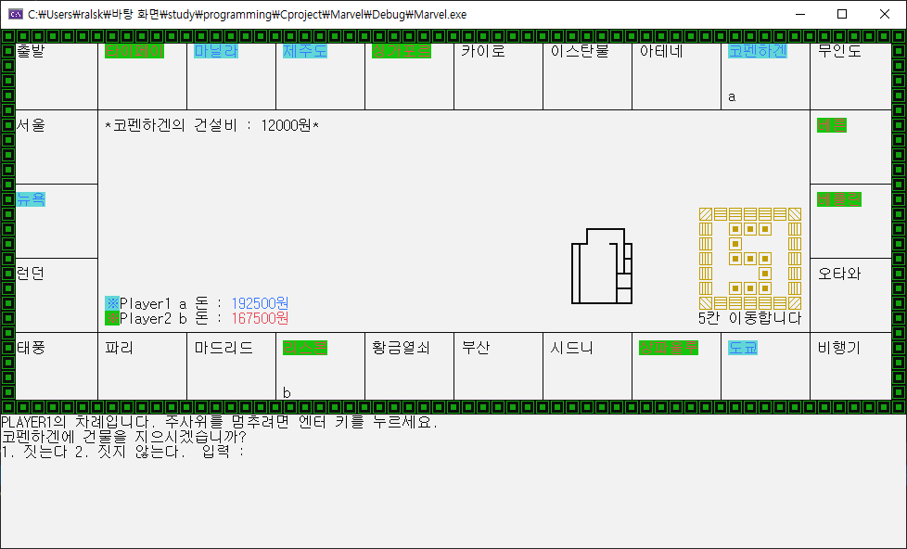
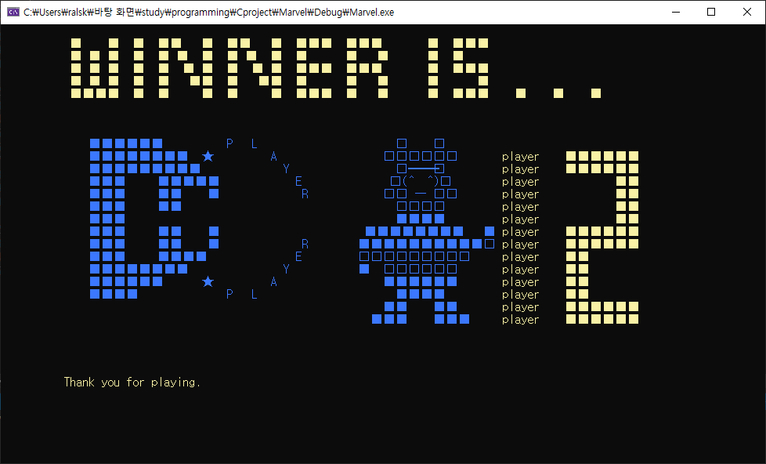
Start Scene
04
Blue
Marvel
InGame Scene
Ending Scene
2018.10
~ 2018.12
Summary
It is a work that implements the Blue Marble game with C.
Mingyu Kim
Term Project, For two-player game
Various Background Sound
You can buy land or buildings with the money you have.
If you run out of money, you can sell land or buildings or go bankrupt.
There are service compartments such as uninhabited island, golden keys, and airplanes.
My Contribution
Personal Project.
All Part
Github URL : https://github.com/ralskwo/BlueMarvelGame/tree/master

Slide 10
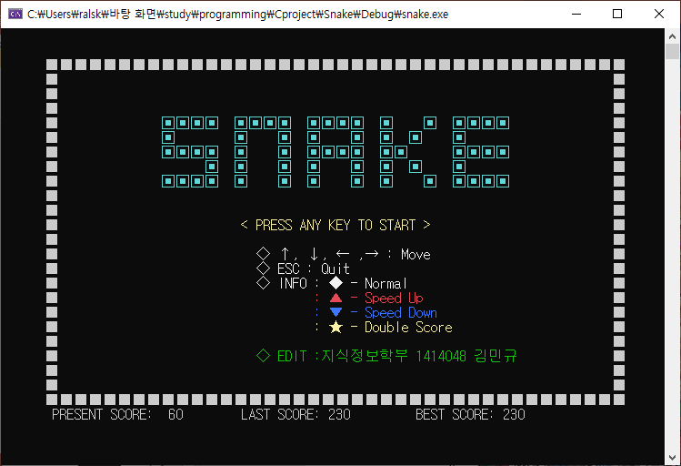
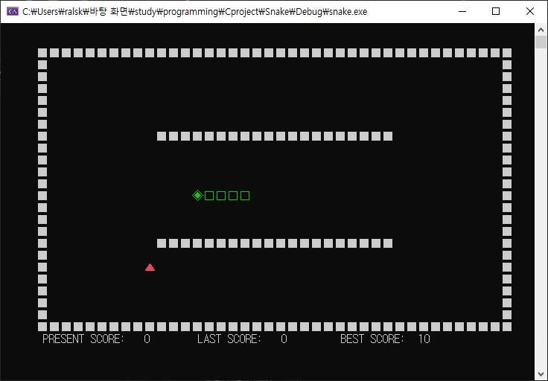
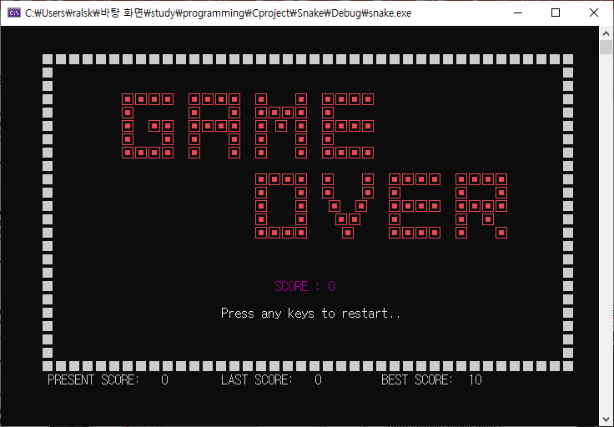
Start Scene
04
Snake
Game
InGame Scene
Ending Scene
2019.05
~ 2019.06
Summary
It's a snake game where your tail gets longer when you eat an item.
Mingyu Kim
Term Project
The length of the tail increases when an item is acquired.
If you hit a wall or your tail, you'll die.
Stores and displays the current score, previous score, and highest score.
My Contribution
Personal Project.
All Part
Github URL : https://github.com/ralskwo/BlueMarvelGame/tree/master

Slide 11
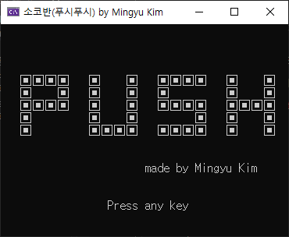
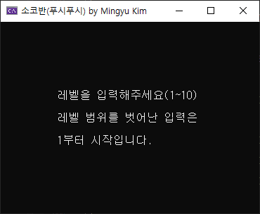
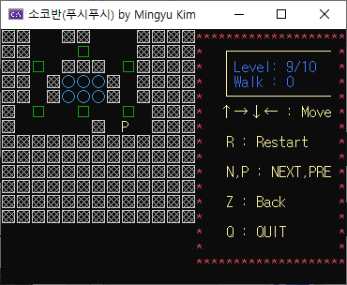
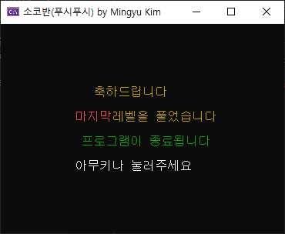
Start Scene
Select Level Scene
04
Push
Push
InGame Scene
Ending Scene
2019.08
~ 2019.08
Summary
This is a Sokovan game implemented with C.
Mingyu Kim
It is a game that pushes □ to the position of ○.
Includes the ability to restart and revert.
You can clear the stage to raise the level or move the level directly.
Check the amount of movement.
My Contribution
Personal Project.
All Part
Github URL : https://github.com/ralskwo/PushPush

Slide 12
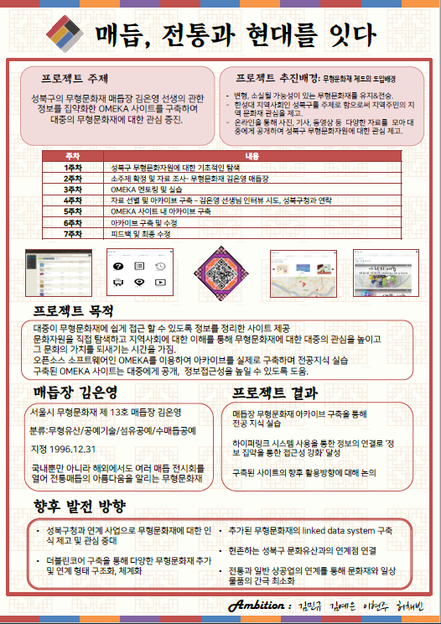



04
Knot
Specialist
2019.10
~ 2019.12
Summary
This is a project to introduce the Korean traditional crafts, Knotjang.
Mingyu Kim
Yeeun Kim
Hyunjoo Lee
Chaebin Huh
The Omega Tool was used to create promotional websites.
It used the Omeka tool to define metadata and to define the connection relationship of the data.
I designed the homepage by writing simple Html and Css code.
My Contribution
Coding website with Omeka
Collecting Data

